Slide 1
Socket Programming
Client/Server Chat Application

Slide 2
Socket
Socket
Source ( IP , Port )
Destination ( IP , Port )
Protocol ( TCP , UDP , SCTP)
Connection Oriented / Connection less

Slide 3
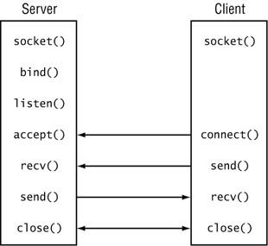
Connection Oriented Socket

Slide 4
Socket Functions
TCP | UDP
socket bind listen accept connect write /send read / recv | socket bind sendto recvfrom

Slide 5
Socket Functions
socket: creates a socket of a given domain, type, protocol (buy a phone)
bind: assigns a name to the socket (get a telephone number)
listen: specifies the number of pending connections that can be queued for a server socket. (call waiting allowance)
accept: server accepts a connection request from a client (answer phone)
connect: client requests a connection request to a server (call)
send, sendto: write to connection (speak)
recv, recvfrom: read from connection (listen)
shutdown: end the call

Slide 6
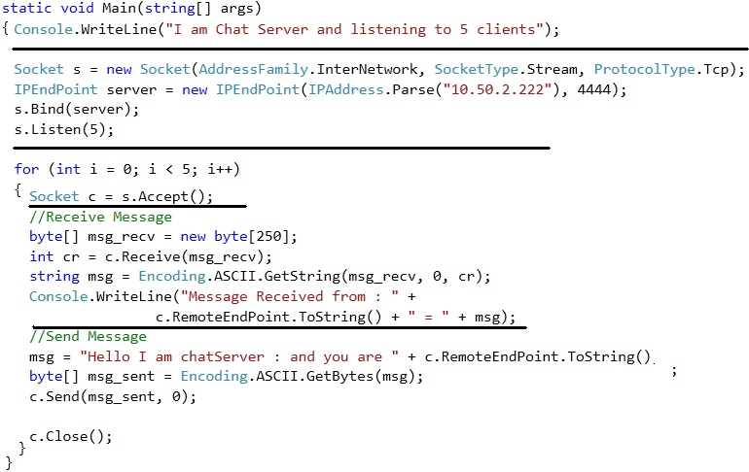
Chat Server

Slide 7
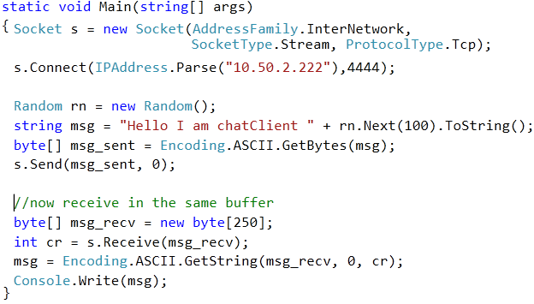
Chat Client

Slide 8
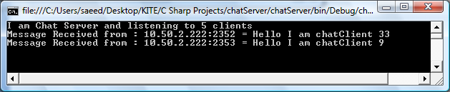
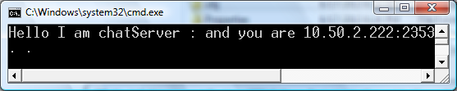
Output

